Slide 1
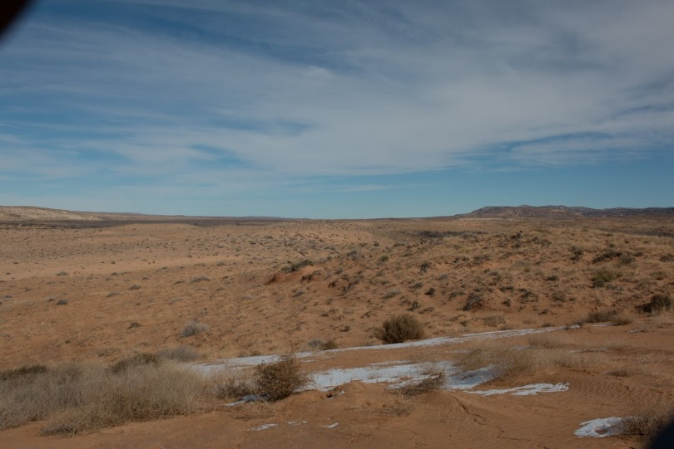


Effects of Sediment Source on Dune Activity
Navajo Nation, Arizona
Annette Sunda mentored by Dr. Lee Amoroso
Northern Arizona University, Department of Geology
Photo credit: Annette Sunda

Slide 2
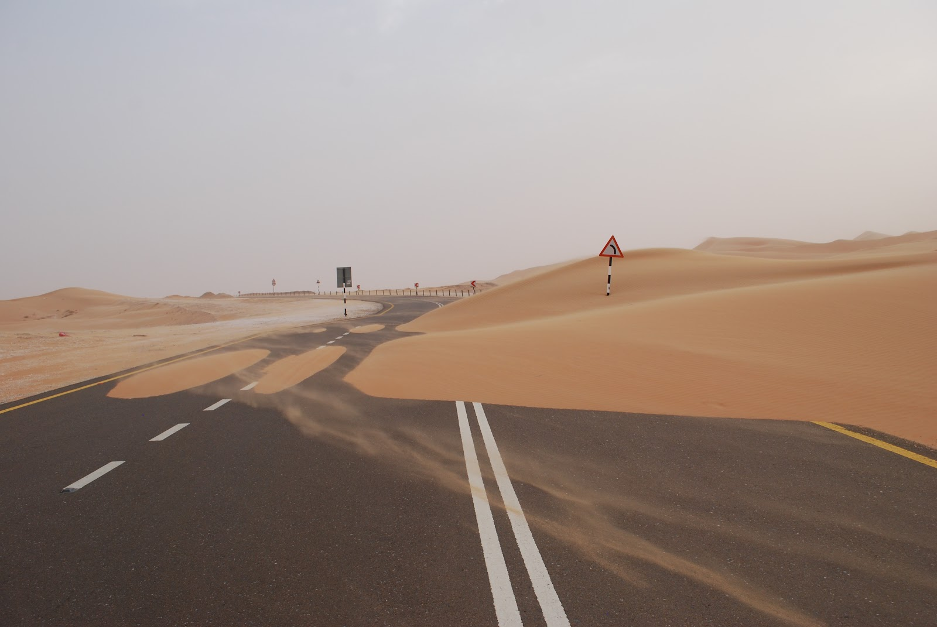
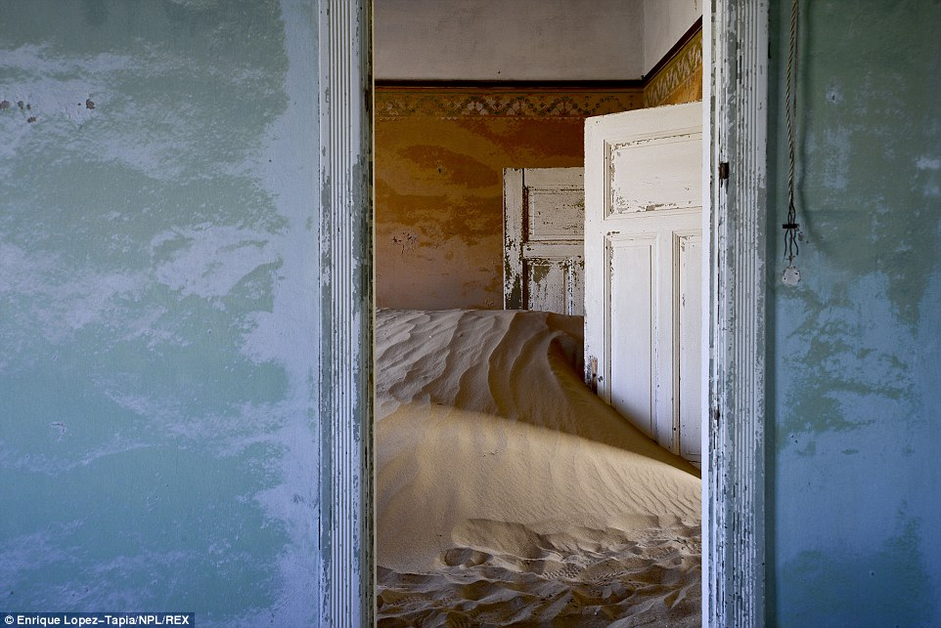
Poor air quality
Hazardous driving conditions
Buried roads and houses
Impacts on Society
Photo Credit: Gary Scudder
To mitigate any problem we must first understand the controlling factors

Slide 3
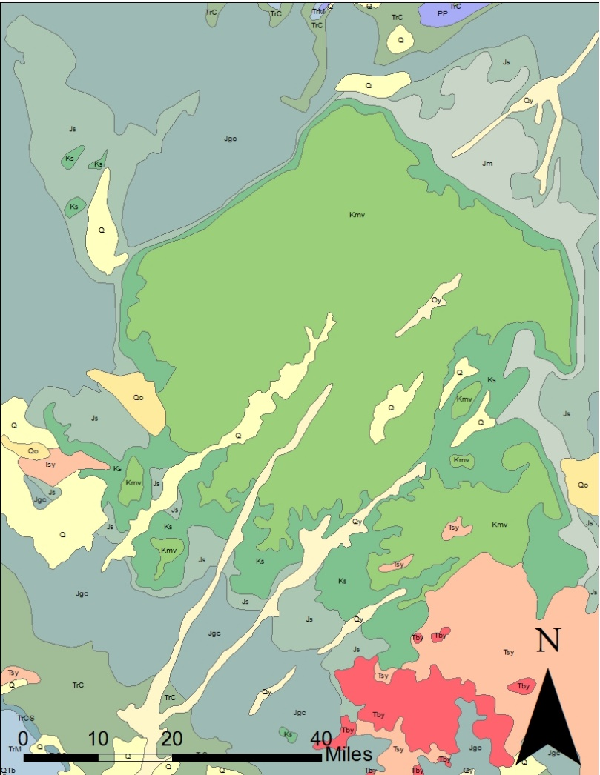
What affects dune activity?
Regional Geology
Cretaceous Marine
Field area north top of Black Mesa
Jurassic Aeolian
Field area north of Black Mesa

Slide 4
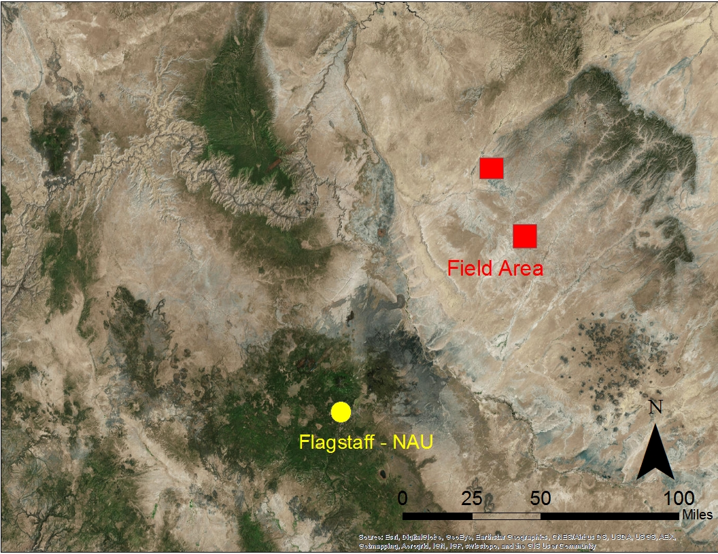
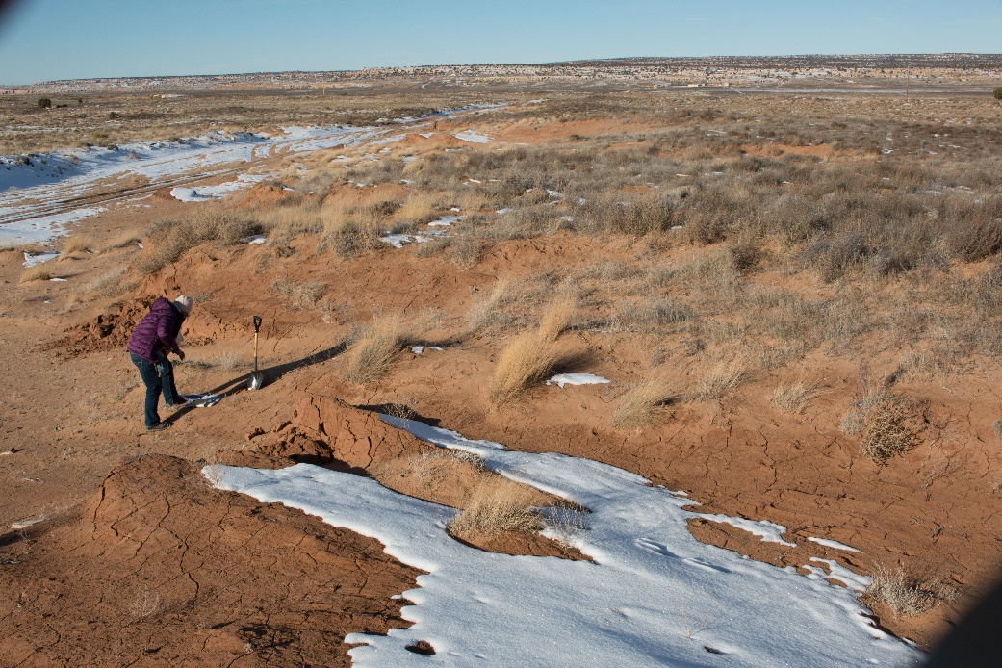
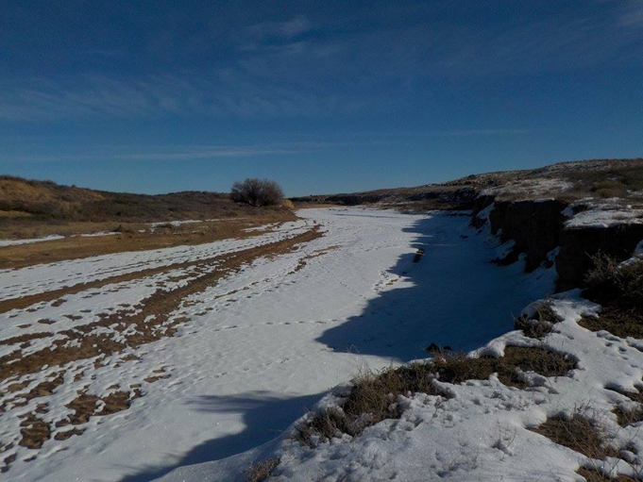
Geography of Sediment
Tonelea
Hotevilla
Photo credit: Andrew Liebig

Slide 5
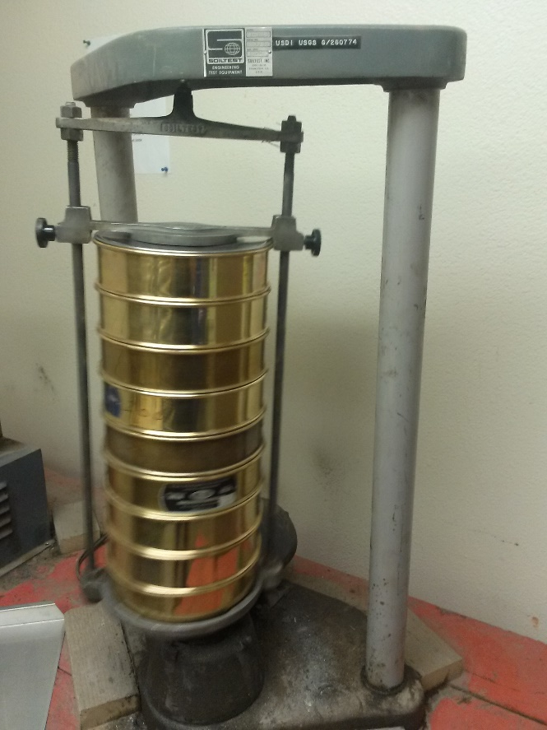
Sieve used to separate sand by size
Photo credit: Annette Sunda

Slide 6
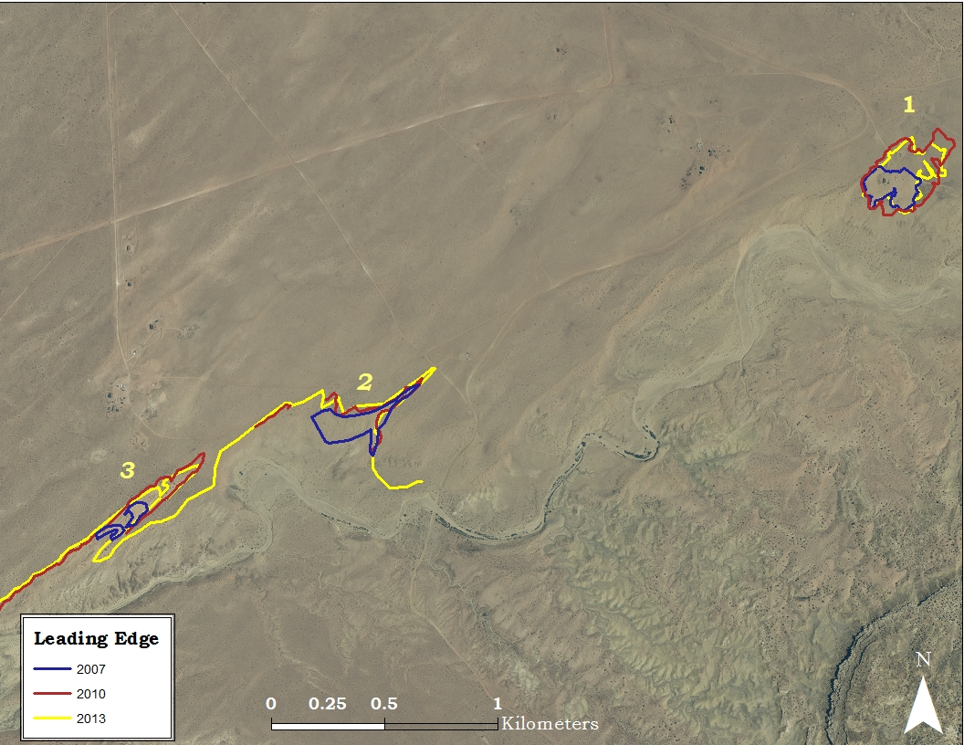
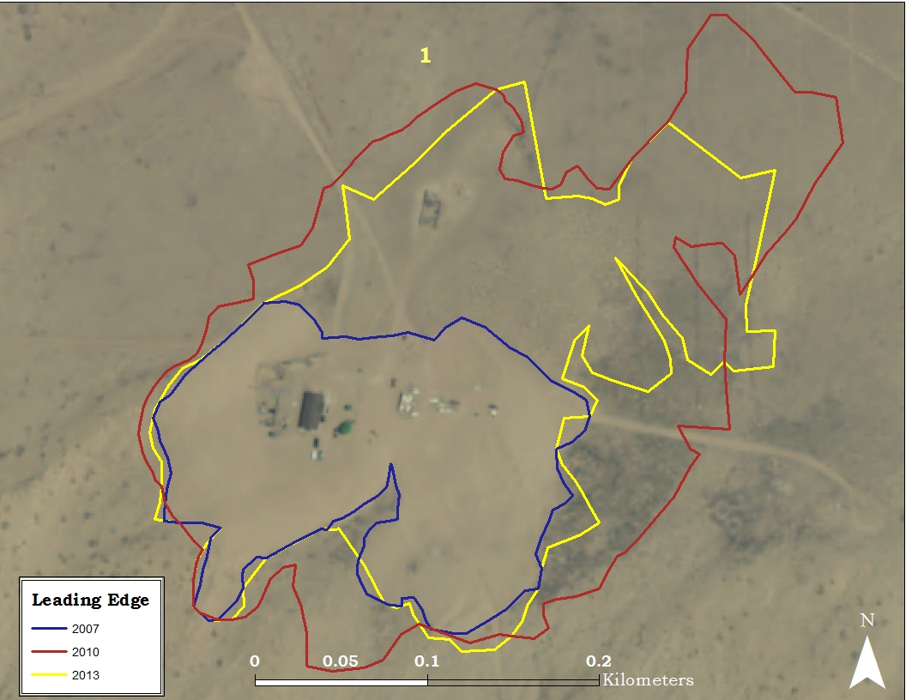
Dune activity at Tonelea

Slide 7
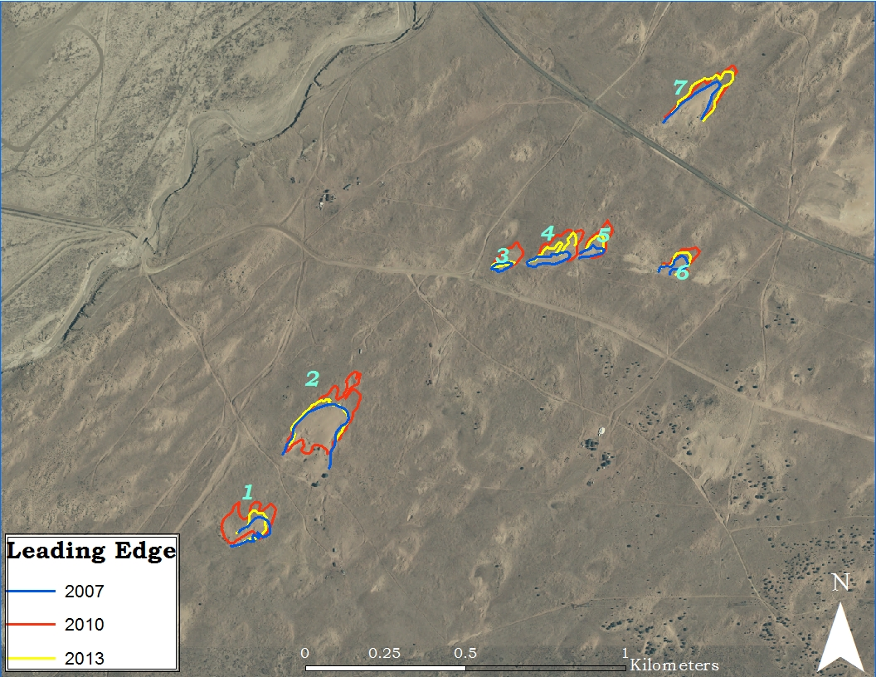
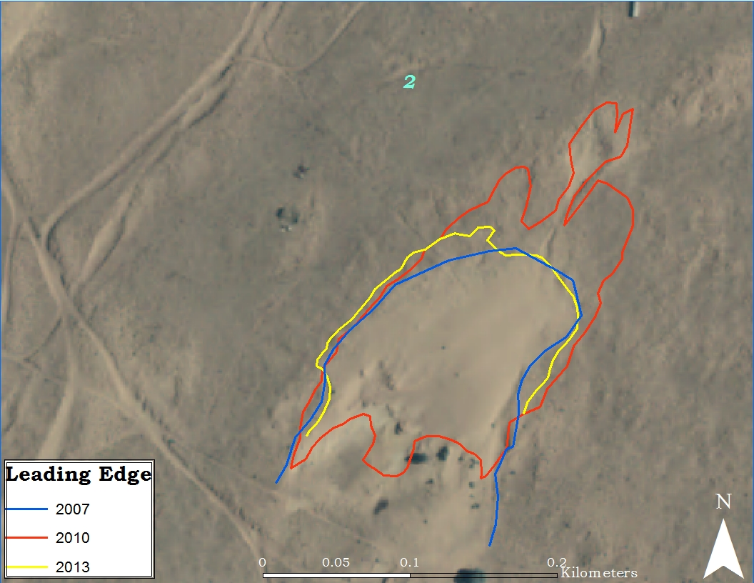
Dune activity at Hotevilla

Slide 8
Summary
Tonelea:
Fine size sand (.125mm)
Average rate of movement 5.14 meters/ year
Finer Sand with distance from source
Hotevilla:
Medium size sand (.25mm)
Average rate of movement 3.27 meters/year
Dune Density Comparison:
For the same measured area Tonelea has 3 dunes, Hotevilla has more than 7 dunes

Slide 9
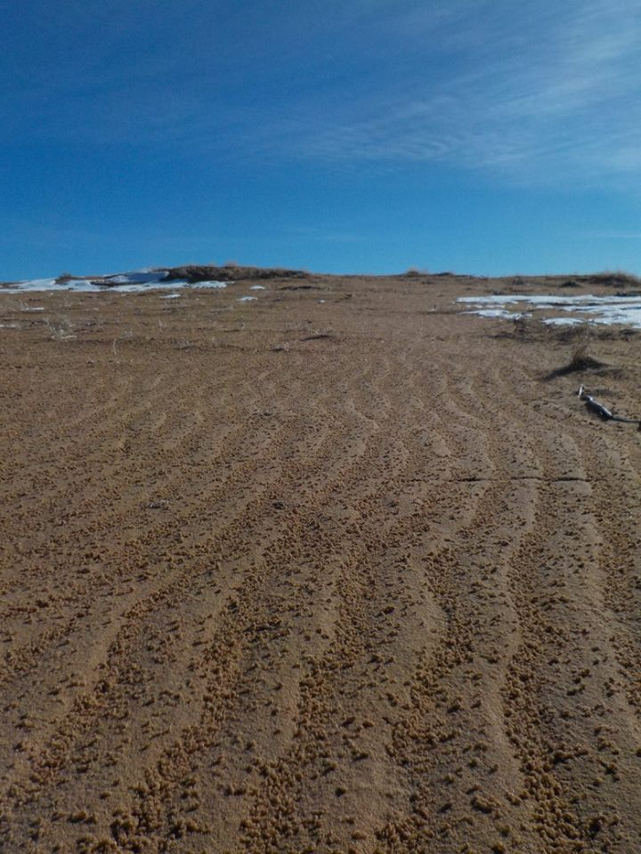
Conclusions
Higher up mesa is relatively coarser than lower on the mesa.
In the lower areas of Black Mesa the sand becomes finer as distance from the source drainage increase.
Affects of Sediment Source
Tonelea: Fine grain sand forms a few large dunes that are prone to activity.
Hotevilla: Medium grain sand form a lot of small dunes that grow and shrink but at a slower rate than fine grain sand.
Photo credit: Annette Sunda

Slide 10
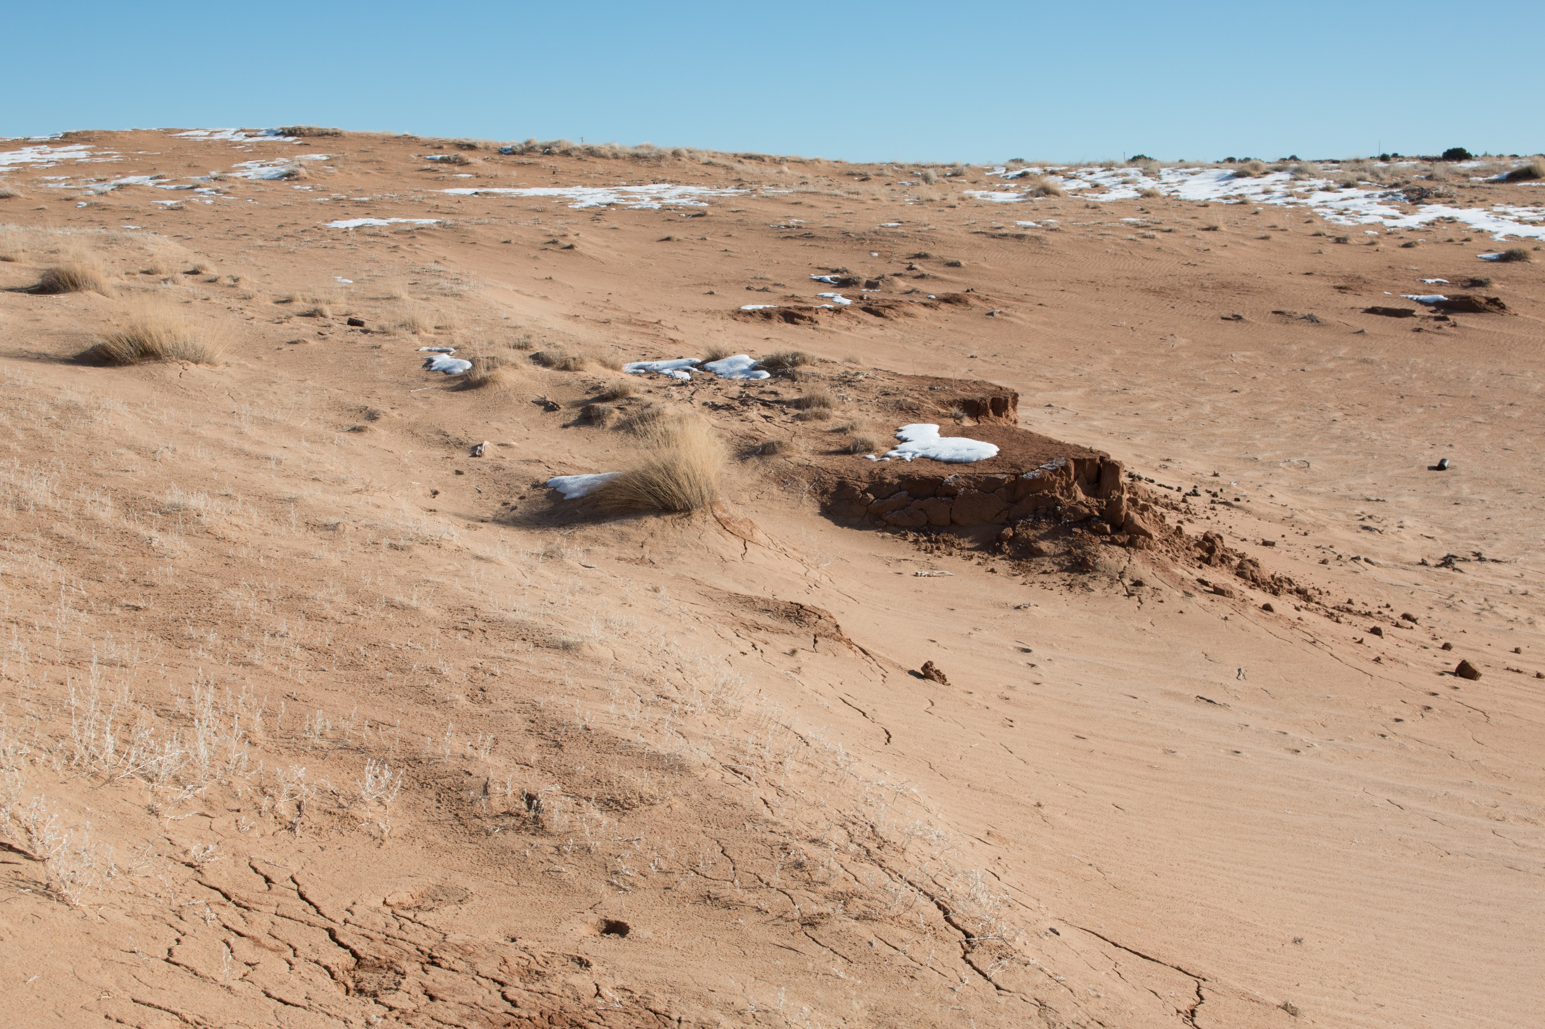
Thank You
NAU/ NASA Space Grant
  Dr Nadine Barlow
  Kathleen Stigman
My Mentor
  Dr Lee Amoroso
Photo credit: Annette Sunda

